Slide 1
Software Engineering
Chapter 3

Slide 2
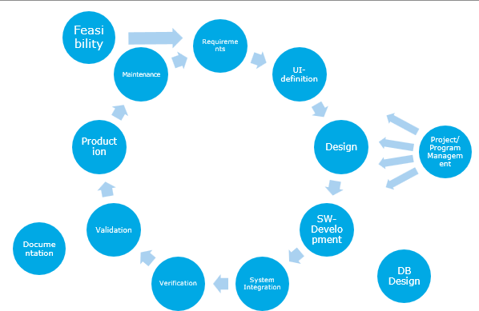
SDLC
Requirements

Slide 3
What are requirements
WHAT should the software do
(Typically) Says nothing about internal operation (HOW something should work)
No implementation details
When given a problem, most people will try to ‘solve’ the problem using their own background knowledge
The solution proposed is NOT the requirement
FIRST STEP, but also consider the other SDLC steps
Notes:
Even in Waterfall there is some iteration taking place on individual steps. You first state high level requirements, that will then be broken up in smaller pieces.
But also looking at e.g. the testing faze, you will need to include requirements that are specifically enough so that at the end when the SW is delivered for validation, that these requirements can be objectively tested and so that show that the SW meets these requirements.

Slide 4
Establishing requirements
The customer is king: He/She owns the budget and will pay at the end.
Developer: Uses SW skills and wants to be paid
A ‘contract’ is needed on what software to build so that the customer will pay the developer.
Scope - the what - is important: Customer will pay for what was asked for
Academic approach: ONLY specify the WHAT, not the HOW
Industry approach: mixture of both, with focus on WHAT.
+ Iterative process: Discussions of Developers/stakeholders will lead to focus more on ‘HOW’ the more they meet
Notes:
Stakeholders may have direct experience with technical issues and are used to specifying solutions, not just problems.​
Past project failures due to misunderstood expectations make some organizations "over-specify" solutions to avoid ambiguity.​
Legacy systems and integration requirements sometimes require very precise implementation details up front, especially in environments with complex enterprise architectures.​
Vendors and external partners frequently request detailed specs to confirm feasibility or to price the project, forcing requirements to mix "what" and "how".​
Consequences:
Missed Business Needs: Focusing too much on "how" distracts from the actual business problem. For example, insisting on an outdated technology because “that’s how it’s always been done” may result in a system that doesn’t actually solve stakeholder needs or isn’t future-proof.​
Conflict and Change Management: When requirements are too prescriptive, any change to technology or approach later in the project becomes harder, leading to scope creep, costly redesigns, or stakeholder disagreements.​
Innovation Loss: Developers are prevented from proposing efficient alternatives when implementation is dictated in the requirements.​
Ambiguity: If "how" is described in vague terms, it can lead to misunderstandings, rework, and missed expectations at delivery.

Slide 5
What to describe
REQUIREMENTS | WHAT / HOW
Functional requirements | WHAT + (NO HOW)
Data requirements | WHAT + (NO HOW)
Non-functional requirements
Performance requirements | WHAT + Some HOW
Constraints | WHAT + HOW
Guidelines | Some WHAT + HOW

Slide 6
Establishing requirements: Requirements Engineering
What exactly does the customer want?
Functional requirements: WHAT Only
Something the SW needs to do (actions)
Data requirements: WHAT only
Define inputs and outputs (from/to the end-users and other systems)
Performance requirements: WHAT and some HOW
Budget, Delivery date,
Response times, throughput,
Communication speed, processing speed,
Integration with legacy systems, …
Constraints: WHAT + HOW
Available processing power and available memory,
Budget,
Size of the team,
Availability of testing capabilities,
Language to use,
Interfacing with other systems
Guideline: Some WHAT + More HOW
Guidance on choosing 1 option if there are multiple options known upfront
Notes:
Example functional: The system shall continuously display the temperatures of all the machines.

Slide 7
Sample requirement
"On a dry track, the train of maximum 100 tons should be able to depart on a gradient of up to 30 degrees with an acceleration of at least 30km/h/h."
Says nothing about how to build the train
Engine
Form
Number of wheels

Slide 8
Specification vs implementation
Specification and implementation are inseparable
Specification may depend on implementation of an existing system
E.g. a library that works with a paper-based lending system
Implementation of existing system
Cards with customer data
Cards with book data
Specification new system
Be able to maintain customer records
Be able to maintain book records

Slide 9
Specification vs implementation
Implementation may be impossible because of technical reasons
Is it possible to retrieve, recalculate and display data within 0.1 seconds
Implementation must be taken into account to estimate cost and completion date
Notes:
Eg: routers and switches in operation of 100Mbps instead of 1Gbps

Slide 10
Good Specification SHOULD BE
Implementation free
No implementation details are required
Complete
Each requirement is listed
Consistent
Requirements should not contradict each other
Unambiguous
Each requirement can only be interpreted in one way
Concise
Each requirement occurs only once
Notes:
Eg: Server available -> retrospective in requirements, still software so only limited use.
Unambiguous: Do not use subjective words

Slide 11
Good Specification SHOULD BE
Minimal
There are no unnecessary requirements, which are e.g. already contained in other requirements
Understanding
Everything is clear to both client and developers
Feasible
All requirements are technically and economically feasible
Testable
All requirements are testable

Slide 12
(Incorrect) Example: Phone book APP
"Write a program in Java for a personal phone book. The program should include functions for looking up a number and for adding a number. The program should also have a user-friendly interface."
Notes:
Issues:
Java: How, not what
Two functions inadequately described
User-friendly interface: Too vague, what is user-friendly?

Slide 13
Problems (I)
Specifies how, not what
The requirement says “write a program in Java.”
This dictates an implementation detail, not a user need.
Requirements should describe what the system must do, not how it will be built.
Example of a better phrasing:
“The system shall provide functionality for users to store and retrieve contact information.”
Too vague / subjective language
The phrase “user-friendly interface” is subjective — what’s “friendly” to one user might not be to another.
Good requirements must be measurable or testable.
Better:
“The system’s interface shall allow a user to perform add or lookup operations with no more than three clicks.” or “The system shall pass usability testing with a minimum score of 80% satisfaction.”
Incomplete functionality description
Only two functions are listed: lookup and add.
What about deleting, editing, or saving data? Are there limits on the number of entries? Persistence?
Requirements should cover the full expected behaviour or clearly define scope.
Mixes requirements and design
“Program in Java” and “user-friendly interface” are design-level details, not requirement-level.
Requirements should remain implementation-independent so that later design choices remain flexible.
Not traceable or testable
It’s unclear how one would verify that “user-friendly” or “functions for looking up a number” have been implemented correctly — the requirement lacks measurable acceptance criteria.

Slide 14
A Better Version (Iteration 2)
“The system shall allow a user to store contact names and associated phone numbers, and to retrieve a phone number by searching for the contact’s name. The system shall allow users to add new contacts. All contact data shall be retained between sessions. The user interface shall allow these operations to be performed with no more than three user actions.”

Slide 15
Problems (II): Incomplete Functionality Description
“The system shall allow a user to store contact names and associated phone numbers, and to retrieve a phone number …”
That’s too limited & ambiguous — it doesn’t define:
What happens if a number already exists?
Can users delete or edit contacts?
Is data saved permanently or only while the program runs?
How should errors be handled?
This makes it impossible to tell if the program meets user expectations or business goals.
Notes:
3rd item on slide “PROBLEMS (I)”: Incomplete Functionality Description

Slide 16
A Better Version (Iteration 3)
Functional Requirements
The system shall allow users to add new contacts consisting of a name and a phone number.
The system shall prevent the creation of duplicate contact names.
The system shall allow users to retrieve a phone number by searching for a contact name.
The system shall allow users to modify or delete existing contacts.
The system shall store all contact information persistently so that data remains available after program restart.
Look at : “Example requirements document-v1.md”

Slide 17
Problems (III) : little validation criteria
The original requirement includes :
“The program should also have a user-friendly interface.”
How do you test “user-friendly”? It’s subjective — there’s no pass/fail criterion.
Notes:
3rd item van slide “PROBLEMS (I)” :Incomplete Functionality Description

Slide 18
A Better Version (Iteration 4)
Better, Testable Requirements (Non-Functional Requirements)
The system’s user interface shall allow a user to add, delete, or search for a contact within 3 or fewer actions.
Lookup operations shall return results within 1 second for databases of up to 10,000 contacts.
The system shall be usable by a first-time user with less than 5 minutes of training.
The system shall pass usability testing with at least 80% satisfaction among 10 or more test users.
Each requirement can be traced to a test (performance test, usability test, functional test, etc.).
Each one can be verified objectively.

Slide 19
Problems (IV)
Add whatever makes the requirements document clearer
=>Look at the SRS-template: “Requirements template.md”
Notes:
SRS= Software requirements Specification

Slide 20
A final version for our APP
Example requirements document-v2.md
Final version = the version that everybody agrees upon
Developer(s), including Designers, Testers, Delivery
Customer(s)
(And management)

Slide 21
rECAP

Slide 22
The actual requirement specification
A whole process preceded before the requirement specification is finalised
Listening to the customer
Putting everything on paper
Negotiating with the customer
Very important document

Slide 23
Steps to good specification
Listen
Conversations between client and developer
What the customer asks
What the customer needs
NOT: What you THINK the customer needs.
Ambiguity => state context and ask more questions.
Thinking
Developer considers requirements
Converting the customer's point of view to system specifications
Writing
The developer describes what the system should be able to do
Everything is broken down into customer requirements
Culminates in a requirement specification document
Notes:
Listening: asking questions to better understand the user, putting yourself in the customer's point of view.

Slide 24
Form of specification
Two possible approaches
Natural language supplemented by use case diagram
Two documents
Requirement specification in natural language as contract between client and developers
Technical specification in a more formal language for developers (UML)
Both methods still have shortcomings
Notes:
Both documents should remain consistent

Slide 25
Issues with Requirements doc

Slide 26
Possible problems (I)
Different end users have different views
Management wants low cost, good performance and be able to monitor usage
Operators want ease of use, to transfer some of their work, but not that usage is logged or that they get more work
The user wants more than budget and time allows
Negotiations are necessary to reach an agreement

Slide 27
Possible problems (II)
Users and developers speak different languages
A developer's technical language is not always understandable to the customer
The customer often uses vague terms such as "fast," "flexible," "fault-tolerant," ...
Customer demands that are not always compatible
Customer is SME in his domain (slang usage)
The customer forgets important aspects
What to do when an error occurs
A user who enters incorrect data
Connecting to a server that is unavailable

Slide 28
Possible problems (III)
Customer makes unreasonable demands
Asks impossible things of the system
Asks very simple things of the system

Slide 29
Form of specification
Consider the following factors
How detailed is the document formatted
Only what, not how
For whom the document is intended
User/customer
Developers
What notations are used
Informal: natural language
Formal: mathematical and scientific
Mix of both: natural language supplemented by diagrams, tables, ...
Notes:
Formal: safety-critical software

Slide 30
Functional Requirements
USE CASES
USER STORIES AND USER STORY MAP
Notes:
User Stories: Agile terminology
Use Cases: Waterfall terminology

Slide 31
User Stories/USE CASES
Textual description of a user interaction with the system
Used frequently in functional requirements
Identify common actions
Is often supplemented with use case diagram

Slide 32
UseR STORIES
“As a [type of user] I want [some particular feature] so that [some benefit] is received.“
Consist of
Name of the use case
Actor or user of the use case
Description of the use case
Result
What are the results of this use case
Can be divided into minimum and success outcomes

Slide 33
Use Cases/USER STORIES
Consist of
Trigger
What brings one into this use case
Roadmap
What steps are completed at least from beginning to end of the use case
Extensions or alternative paths
What happens when the user performs a certain action that deviates from the normal roadmap

Slide 34
Example
Withdrawing money from ATM
Use case step | Elaboration
Name | Money Collection
Actor | Customer of bank, server of bank
Description | The customer withdraws money from the ATM and the bank server reduces the customer's account
Result | The customer received money. The customer's bill was reduced.
Trigger | The customer chose to withdraw cash from the ATM menu.

Slide 35
Example
Withdrawing money from ATM
Use case step | Elaboration
Roadmap | The customer inserts his card into the vending machine The customer enters his pin code The machine checks the pin code The machine displays the selection menu Customer selects the cash pickup option The customer selects an amount The machine contacts the server to check the customer's account The machine gives the requested amount The machine contacts the server to withdraw the amount from the account Customer asks for his card back The vending machine returns the customer's card

Slide 36
Example (Look at the notes)
Withdrawing money from ATM
Use case step | Elaboration
Alternative steps | 3a1. The pin code is wrong 3a2. The machine asks the customer for the PIN code again 8a1. The amount in the customer's account is too low 8a2. The machine reports this on the screen 8a3. The machine returns the customer's card 8b1. The machine does not possess enough money 8b2. The machine reports this to the customer 8b3. The machine again displays the selection menu 10a1. Customer forgets to ask for his card back 10a2. The machine signals this on the screen 10a3. The machine emits a signal 10a4. Customer asks for his card back 10b1. Customer forgets to ask for his card back 10b2. The machine signals this on the screen 10b3. The machine emits a signal 10b4. The machine swallows the card
Notes:
Writing User Stories, It’s about the conversation – An Agile Mind => https://anagilemind.net/2017/10/21/lets-take-a-journey-on-writing-user-stories/
How to do User Story Mapping => https://www.youtube.com/watch?v=k_4SchJgAI4

Slide 37
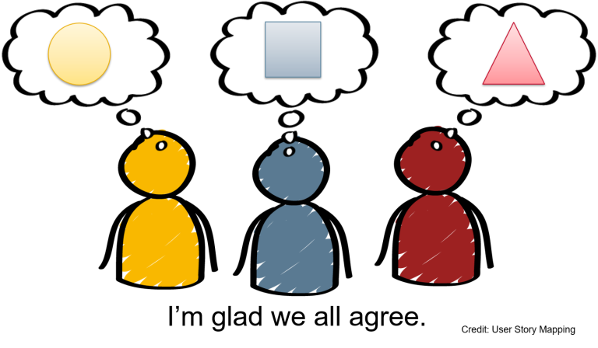
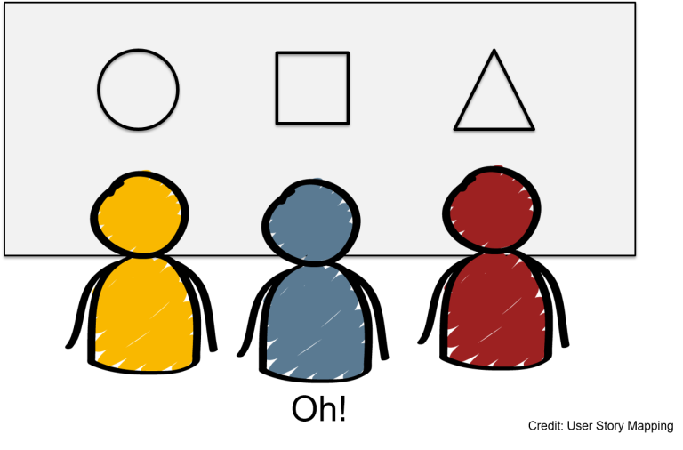
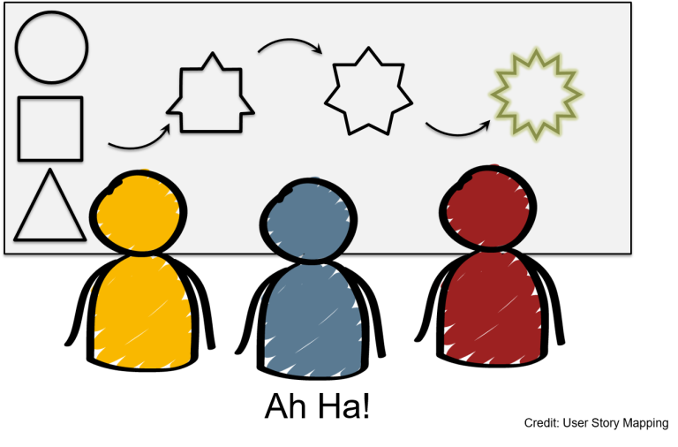
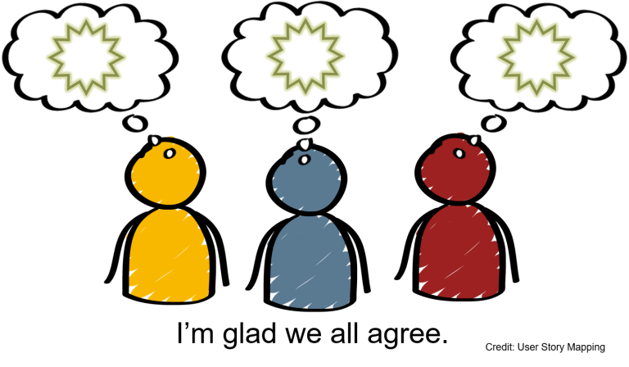
Recap

Slide 38
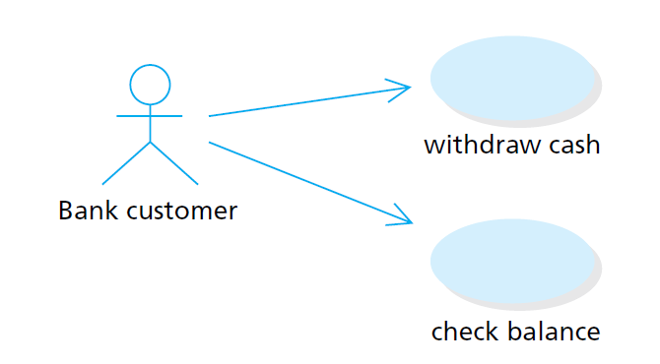
Use case Diagram
UML diagram to support a use case
Very simple representation of actors and functionality of a system

Slide 39
What makes a good user story?
A title (often forgotten): the name of your feature (e.g., shopping cart).
A short description of the functionality: who is it for, what is the purpose, and why. Usually formulated as follows:
As a <type of user>, I want <some goal> so that <some reason>.
E.g., As a customer, I want to be able to add products to my shopping cart so I can keep track of what I'm about to order.
Acceptance criteria: Criteria that indicate whether the story has been executed as the user expects. These can be both functional and non-functional requirements.
E.g., the shopping cart is accessible from every page, the shopping cart has a clear table consisting of...
Possibly other details that clarify the feature, such as sketches, UML diagrams, etc.

Slide 40
BACKUP – More details on Requirements Doc

Slide 41
Structure of the specification
It is best to split the specification into some structure
List different parts separately
Break down specifications by types of requirements
A possible structure of the specification
Functional requirements
Data requirements
Non-functional requirements
Performance requirements
Restrictions
Guidelines

Slide 42
Functional requirements
The essence of the specification
Description of what the system should be able to do
Characterized by verbs that capture actions

Slide 43
Data requirements
What can the user enter
How can the user enter something
What is shown to the user
How can the user obtain output
What data should be kept
How should this data be stored
What information is exchanged with other systems, e.g., a server

Slide 44
Non-functional Requirements: Performance requirements
Cost and completion date
Response time of the system
Data volumes
System load
Reliability
Safety

Slide 45
Non-functional Requirements: Restrictions
Usually affect the implementation of the system
Be careful about inserting these restrictions
Can have drastic consequences for an implementation
What hardware is available
Available memory
Speed of processor
Storage available
Collaboration between software and systems
What operating systems should be considered
What systems must be able to communicate with

Slide 46
Non-functional Requirements: Guidelines
When multiple solutions to a problem are present, a particular solution can be chosen via guidelines, e.g.
As little memory as possible should be used
Communication with the server should be limited as much as possible

